Slide 1
Effects of COVID-19 on the homeless population in the state of California
By DFT (Racheal, Elijah and Mark)

Slide 2
Overview of the Presentation
What is COVID-19
What are the impacts of COVID-19 to the world in General

Slide 3
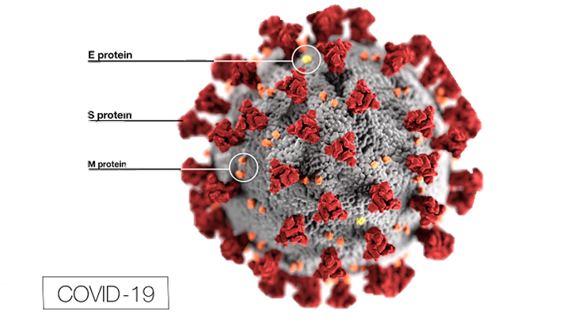
What is COVID-19
COVID-19 is a kind of cornonavirus …
WAIT!! What is a coronavirus?
okay,

Slide 4
What is COVID-19
COVID-19 is a kind of cornonavirus …
WAIT!! What is a coronavirus

